Slide 1


Aggregation in Phosphate Limited Versus Replete Cultures of Marine Synechococcus
Kimberly Mohabir
Mentor: Susanne Neuer
School of Life Sciences
Arizona State University

Slide 2
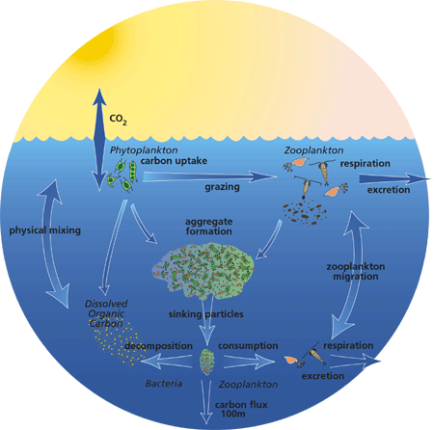
The Biological Carbon Pump

Slide 3
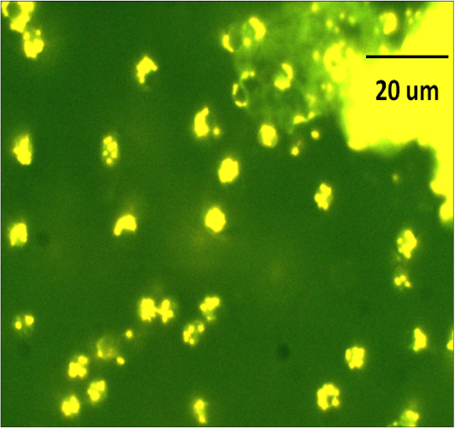
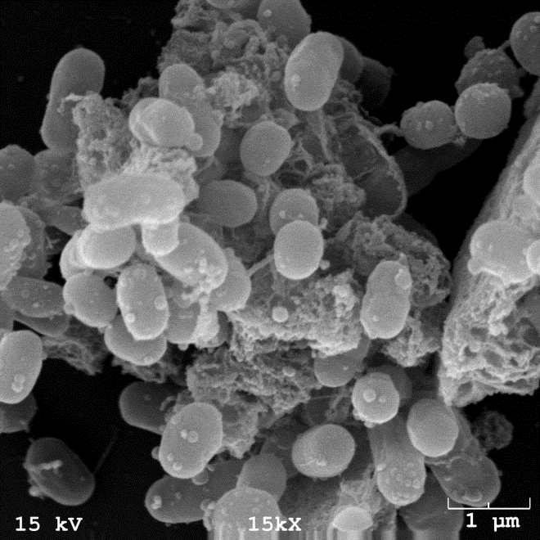
Background
Proterozoic Ocean
  No eukaryotes present, only prokaryotic primary producers
    Prokaryotic primary producers thought to be the ancestors of today’s cyanobacteria
Use of Synechococcus as a model organism

Slide 4
Objective
To determine the difference in aggregation and settling rates between nutrient replete and phosphate limited cultures of Synechococcus

Slide 5
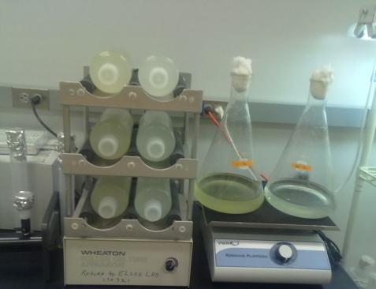
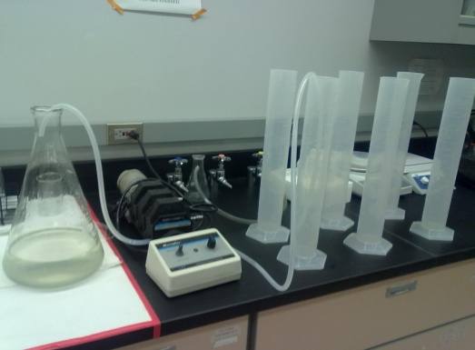
Methods
Phosphate limited culture vs. replete culture
  3 treatments from each culture
    0, 8, and 24 hours of rolling
Settling for 8 hours
Sinking rates, aggregate abundance, and equivalence spherical diameter (ESD) determined

Slide 6
Results: Aggregate Abundance During Rolling

Slide 7
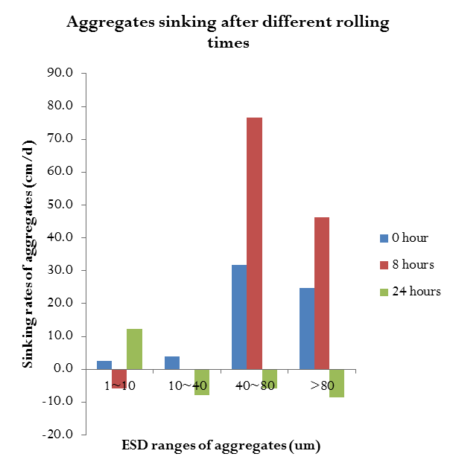
Results: Settling Experiments
Replete Culture
Phosphate Limited Culture

Slide 8
Conclusions
Large aggregates sink faster
  Play important role in biological carbon pump
Relatively low settling rates
  small early carbon export in Proterozoic Ocean
No difference in aggregation between nutrient limited and replete cultures

Slide 9
Acknowledgements
Wei Deng and Dr. Susanne Neuer
The Neuer lab
NASA Space Grant at ASU

